Slide 1
Team Glasses -“Innovating for Mankind”
“Green Route” An Ambulance Guidance and Signalling System for Lightning Emergency Response
Anish Pawar:+91 7710883802 Abhishek Mazumdar:+91 7506580999 Dishant Padalia:+91 9833099156 Jatin Nainani: +91 8976007957

Slide 2
Description of the Project (Pt -1)
Problem Statement
According to the World Economic Forum, a 150,000 people die each day in India.
A Recent Study has showed that around 86,000 people die due to untimely healthcare which accounts for 57% of the deaths.
One of the prime causes for this baneful situation is the traffic. For a country like India, where the population is humungous, commute is a major hassle.
Emergency responses are slowed down in traffic and several lives are lost due to this untimely response.
Techstack Involved
A brief list of the tools and technologies used-
Flutter
Firebase-ML Vision
Firebase
Google Maps API
Node JS

Slide 3
Description of the Project (Pt -2)
Approach to the Solution
The thought behind our innovaton was to aid and expedite the existing emergency response system.
Through our research we came across traffic being the major contributer to this concern. This made us think of a way around traffic control to quicken the response.
We believe to solve for this problem by applying the concept of a “Green Corridor” to a local level.
Our project works on a mechanism of signalling all google map users on the shortest route in a 1 km radius of an ambulance approach and partnering with the traffic control to alter traffic restrictions in that route to create a temporary green corridor making the emergency reponse lightning .
Relevance to the Theme
Our product is based on the theme of open innovation.
It integrates the healthcare and traffic control sectors to provide a rapid emergency response to the individuals in need.

Slide 4
Details of Technology Stack Pt1
Flutter and Firebase-ML Vision
Flutter is a cross-platform UI toolkit that is designed to allow code reuse across operating systems such as iOS and Android, while also allowing applications to interface directly with underlying platform services.
Firebase-ML Vision is used for OCR and computer vision.
Google Maps API
The Google Maps Platform is a set of APIs and SDKs that allows developers to embed Google Maps into mobile apps and web pages, or to retrieve data from Google Maps.
Google Firebase is a Google-backed application development software that enables developers to develop iOS, Android and Web apps.
Firebase provides tools for tracking analytics, reporting and fixing app crashes, creating marketing and product experiment.
Firebase
NodeJS
Node. js is a platform built on Chrome's JavaScript runtime for easily building fast and scalable network applications.
Node. js is an open source, cross-platform runtime environment for developing server-side and networking applications.

Slide 5
Details of Technology: App Work Flow
User Signup
(Firebase User Creation)
User Segregation
Notification Service Setup (Firebase Cloud Messaging)
Active Ambulance (Request for green corridor creation)
Path Matching from user locations in frontend
Ambulance Vicinity Check (All the users in 1km of the Ambulance)
Push Notification (Firebase Cloud Message Push and Node Js)
User Signup
Start Navigation(Google Maps
Ambulance App
Ambulance Personnel Verification
Start Navigation with Green Corridor option
Navigate in Green Corridor created.

Slide 6
Description of the Solution
Search
We initially started our problem finding with a systematic framework through a pool of concerns segregated between individual and business.
We chose to solve for individual lives motivating us to make a huge social impact. This brought us to healthcare.
With breadth searches of problems around the sector and the “5 Why Analysis” we formed our problem statement on critical service delivery.
Plan
With the goal and ideas in mind we started gathering resources both in technology(app development) and skills to build a viable solution to solve this baneful problem.
Step 1
Step 2
2021
Engage
We applied a designed thinking approach to create a pool of ideas in order to solve the problem statement.
We then combined ideas and based on vialbilty to come up with the ideal solution.
Create
Now that we have all the pieces we need started building the application and business model access the viability and create the app.
Step 3
Step 4

Slide 7
Novelty of the Solution
Describe how your solution is unique and original. Our Product is a novel solution to the “critical services delay” problem in the healthcare industry. Our product puts Google maps in a never-used-before manner through our ambulance guidance and vehicle signalling system. The Partnership and Integration with the Traffic Control System enables a local green corridor that allows critical services to reach the site of required response in good time. We also partner with Google Ventures and Google Capital to access their data base and reach as an extended plugin to the maps Why the problem you are catering is needed to be solved? Healthcare has been highlighted as one of the basic needs not only by several nationalities but also the UN(WHO). Healthcare has advanced a lot in the past 10 Years and life expectancy has surged in the recent decade with the ability to combat several dreadful diseases. But even today in many countries, individuals lose their lives to preventable diseases owing to untimely healthcare. Hence, solving this problem is of prime concern.

Slide 8
Growth Plan of the Product
(You can modify percentage according to your requirement)
Begin App delivery to a relative smaller demographic (a locality or a pivot city) to begin the prototype testing phase.
Analyzing the adoption and user patterns in the demographic to develop and deliver the succeeding features
10%
Checkpoint 1
25%
Expanding the delivery to a larger demographic(state or nationwide) as an extended part of the prototype testing phase.
Analyze the adoption and user patterns for the larger demographic and make further developments.
Checkpoint 2
50%
Expanding our services a notch up targeting the global healthcare sector
Checkpoint 3
Extrapolation of the concept to other emergency responses such as fire ,safety, security etc. or secured and faster travel.
Extending services to fire brigades, police, banking assets and cash logistics for banks.
75%
Checkpoint 4

Slide 9
Business Aspects of the Hack
01
Market Impact
Our Product impacts the healthcare industry by solving one of its most baneful problem. The novelty of the idea amplifies the impact our product has to the market.
Target Consumers
02
The target clients for our product are the hospitals and healthcare allies. Our Product is the fine blend of a high social impacting technology and a commercially insentive based technology. Hospitals would acquire this technology as the on time healthcare facilities would draw patients and revenue.
03
Financial Sustainability
Our Product is a B2B based technology aiding the healthcare sector that would utilise a subscription based model to financially sutain itself. It would lend services to hospitals on a yearly contract.
Our product is market ready with most of the features ready for delivery . The potential our product has makes it a revolutionary technology.
04
Product > Project

Slide 10
Social Impact
Describe briefly how this project affects society and whether it solves a social cause and how. According to the World Economic Forum, a 150,000 people die each day in India. A Recent Study has showed that around 86,000 people die due to untimely healthcare which accounts for 57% of the deaths. One of the prime causes for this baneful situation is the traffic. For a country like India, where the population is humungous, commute is a major hassle. We believe to solve for this problem by applying the concept of a “Green Corridor” to a local level. Our project works on a mechanism of signaling all google map users on the shortest route in a 1 km radius of an ambulance approach and partnering with the traffic control to alter traffic restrictions in that route to create a temporary green corridor making the emergency response lightning .

Slide 11
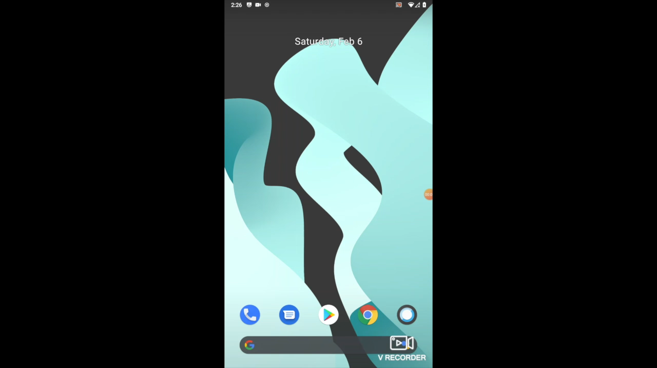
Working Prototype

Slide 12
Learning Curve
What have you learnt by doing this project?
04
01
Growth 1
03
We initally learnt how to ideate systematically by finding problem statements through research and the 5 why analysis and apply the concepts of designed thinking to come up with most viable solution
02
02
Growth 2
We the started with the GUI and frontend services which gave us the idea of flutter packages and dart to enable different functions.
01
03
Growth 3
Next we moved on to the backend and embedded features where we learnt about firebase and Google places API to create the backend and the location services.
04
Growth 4
Finally we learnt front end, backend and other embedded services integration and complete project delivery along with the business and financial modelling to ensure the smooth delivery and adoption of the product.

Slide 13
About Team
01
02
Anish Pawar
Abhishek Mazumdar
Ideation, Frontend and Backend Development
Ideation, Business Development and Modelling
03
04
Dishant Padalia
Jatin Nainani
Ideation, Frontend Development
Ideation, Backend Development

